Slide 1
FINAL INTERNSHIP PRESENTATION | DATA VISUALIZATION
HOSPITAL PERFORMANCE
INTELLIGENCE SYSTEM
Hospital Operations & Patient Care Analytics
MedTrack_DV
Prepared by: Smitha S
Python • Excel • Tableau Public

Slide 2
Project Overview
INTRODUCTION
A connected view of hospital operations
MedTrack_DV turns prepared hospital datasets into an interactive dashboard suite for exploring admissions, patient flow, department activity and resource utilization.
Purpose
Approach
Deliverable
Bring key operational indicators and trends into one interface.
Prepare data, generate KPI summaries and visualize results.
A published Tableau Public workbook with a Home page and four dashboards.
The presentation follows the internship milestones and highlights the implemented dashboard suite.
MEDTRACK_DV | HOSPITAL OPERATIONS & PATIENT CARE ANALYTICS
2

Slide 3
Problem Statement & Objectives
INTRODUCTION
Problem statement
Objectives
Hospital information is spread across multiple datasets. A unified view helps users review activity, compare departments and inspect resource use.
• Organize hospital data for analysis
• Summarize operational KPIs
• Explore admissions and discharges
• Compare department admissions and billing
• Present resource utilization
• Connect dashboard views through navigation
MEDTRACK_DV | HOSPITAL OPERATIONS & PATIENT CARE ANALYTICS
3

Slide 4
Tools & End-to-End Methodology
METHODOLOGY
01
02
03
04
05
Collect
Clean
Analyze
Visualize
Review
Hospital CSV datasets
Inspect and prepare records
Create datasets and KPI summaries
Build Tableau dashboards
Check navigation and document limitations
Tools: Python • Pandas • Jupyter Notebook • Excel • Tableau Public • Git/GitHub
Prepared outputs include datasets and KPI summaries for four connected dashboard views.
MEDTRACK_DV | HOSPITAL OPERATIONS & PATIENT CARE ANALYTICS
4

Slide 5
Milestone 1 — Data Collection & Cleaning
MILESTONE 1
Work completed
Dataset coverage
• Organized raw hospital datasets
• Created data collection and processing scripts
• Inspected tables, columns, record counts and missing values
• Used notebooks to support data inventory and cleaning
• Prepared data for KPI analysis
Patient, admission, bed, ward, department, doctor, billing, diagnostic test, prescription, insurance and staff-assignment records.
Outputs are maintained in the project's data, scripts and notebooks folders.
MEDTRACK_DV | HOSPITAL OPERATIONS & PATIENT CARE ANALYTICS
5

Slide 6
Milestone 2 — KPI Generation & Prototyping
MILESTONE 2
Work completed
KPI summary
• Prepared analytical datasets for dashboard views
• Generated KPI summaries using Python
• Created an Excel workbook with multiple analysis sheets
• Prepared storyboard and KPI documentation
• Built an initial Tableau prototype
Total admissions: 45,000
Average length of stay: 5.155 days
Bed utilization: 34.94%
Occupancy rate: 25.36%
Department efficiency score: 90.13
Readmission rate: unavailable in current summary
Validation note: selected KPI values are fixed display values in the current Tableau workbook.
MEDTRACK_DV | HOSPITAL OPERATIONS & PATIENT CARE ANALYTICS
6

Slide 7
Milestone 3 — Dashboard Integration
MILESTONE 3
One published workbook • five dashboard pages
Navigation hub
Dashboard suite
The Home page introduces the project and links to the four main dashboards.
Hospital Overview • Patient Flow • Department Analytics • Resource Utilization
Navigation buttons were tested on the published Tableau Public workbook.
MEDTRACK_DV | HOSPITAL OPERATIONS & PATIENT CARE ANALYTICS
7

Slide 8
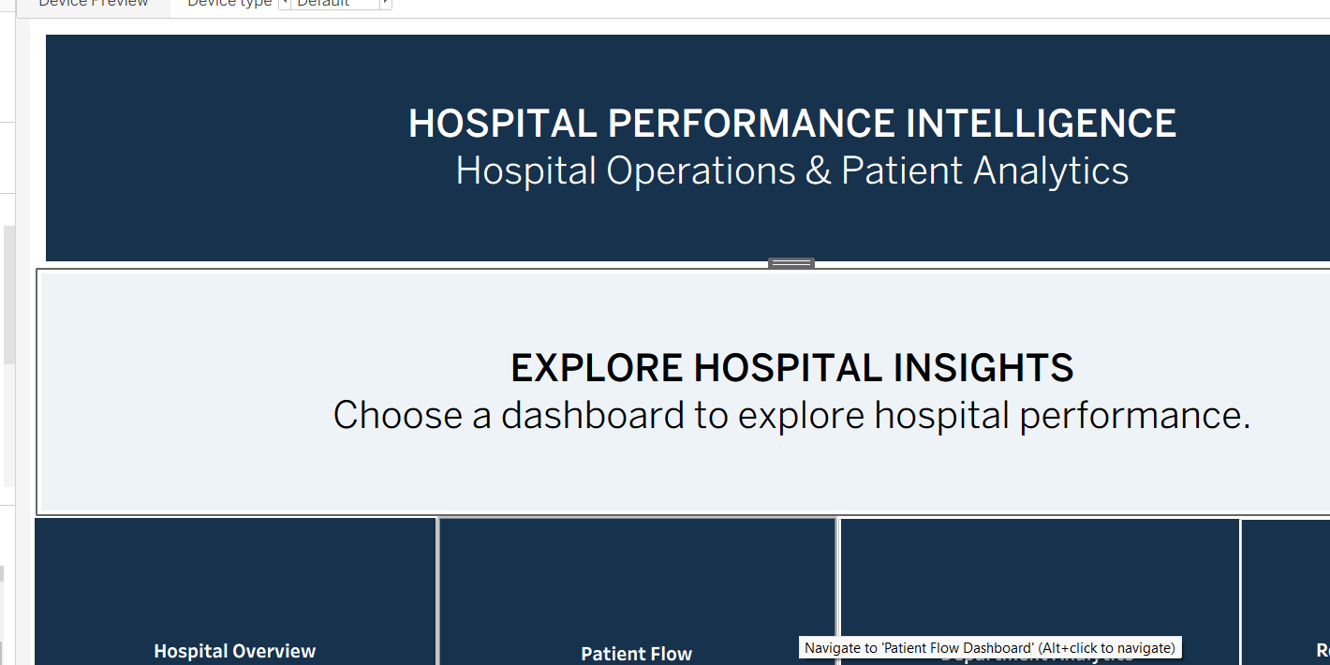
Home Dashboard — Navigation Hub
MILESTONE 3
The Home page links to Hospital Overview, Patient Flow, Department Analytics and Resource Utilization.
MEDTRACK_DV | HOSPITAL OPERATIONS & PATIENT CARE ANALYTICS
8

Slide 9
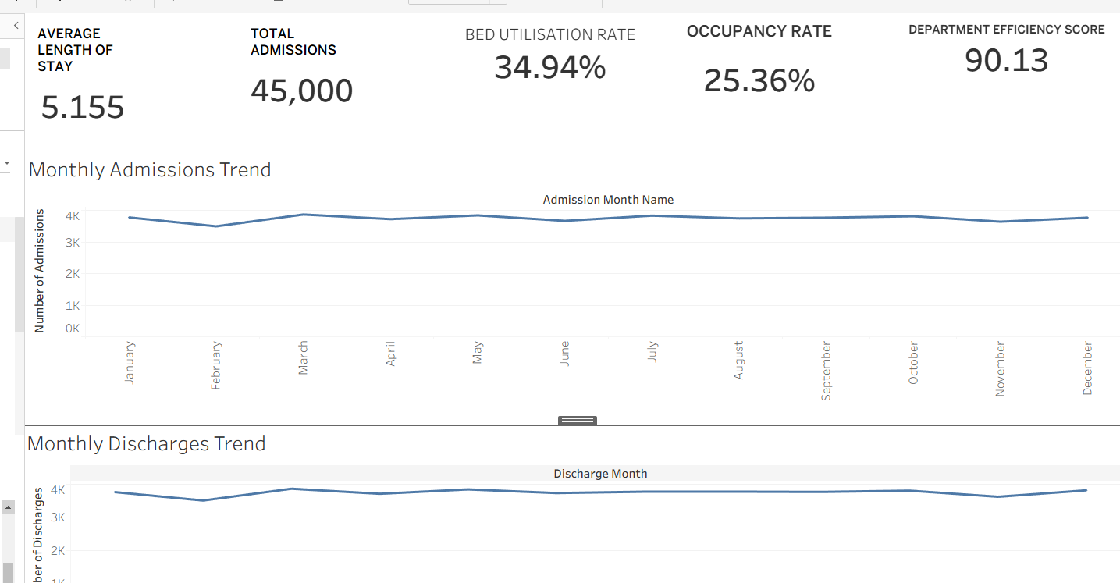
Hospital Overview Dashboard
MILESTONE 3
KPI cards summarize hospital performance; line charts show monthly admissions and discharges.
MEDTRACK_DV | HOSPITAL OPERATIONS & PATIENT CARE ANALYTICS
9

Slide 10
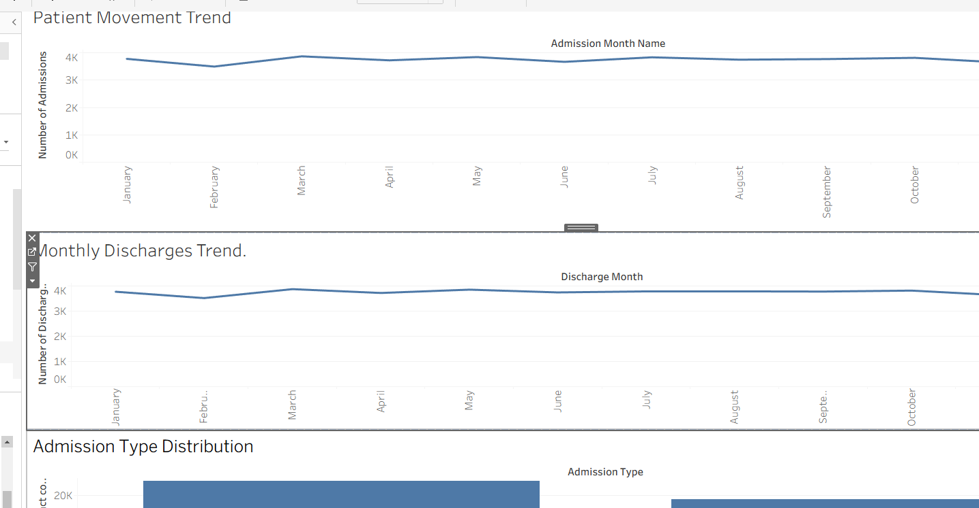
Patient Flow Dashboard
MILESTONE 3
Shows patient movement, monthly discharges and elective versus emergency admissions.
MEDTRACK_DV | HOSPITAL OPERATIONS & PATIENT CARE ANALYTICS
10

Slide 11
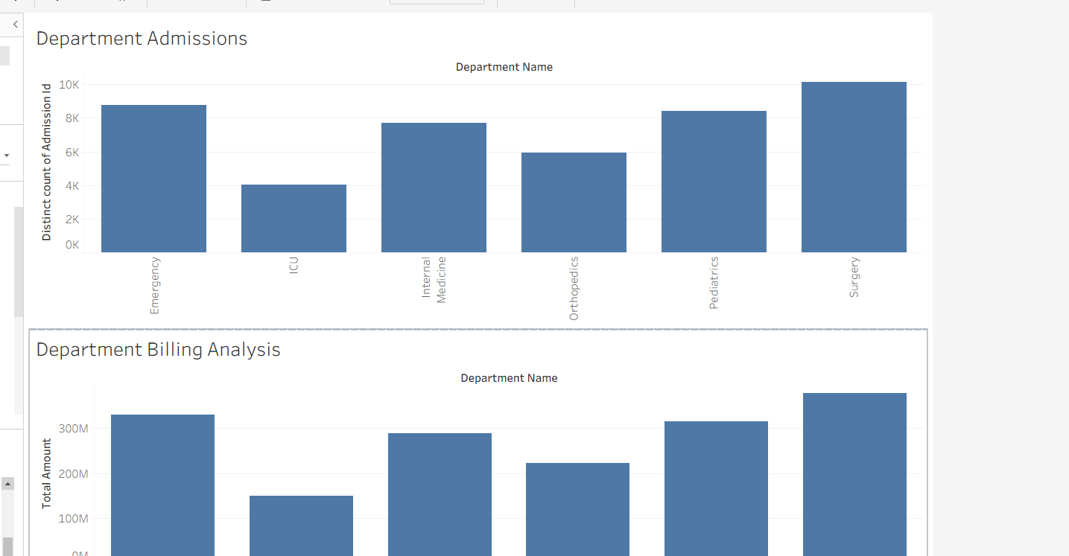
Department Analytics Dashboard
MILESTONE 3
Compares admission counts and billing totals across six departments.
MEDTRACK_DV | HOSPITAL OPERATIONS & PATIENT CARE ANALYTICS
11

Slide 12
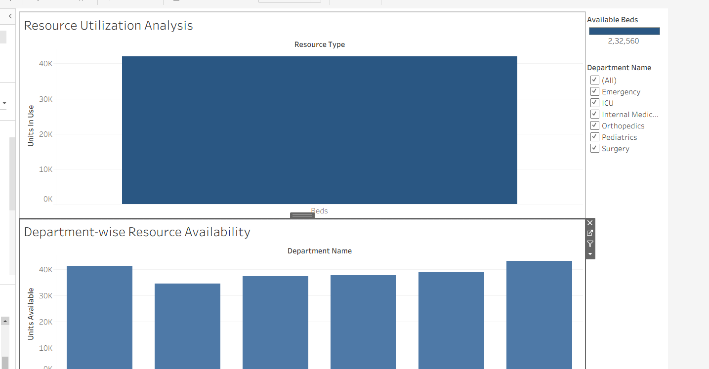
Resource Utilization Dashboard
MILESTONE 3
Shows resource use and department-wise availability; the displayed availability total needs source validation.
MEDTRACK_DV | HOSPITAL OPERATIONS & PATIENT CARE ANALYTICS
12

Slide 13
Milestone 4 — QA & Documentation
MILESTONE 4
Documentation prepared
Quality review
• QA_Checklist.md
• Dashboard_Testing_Report.md
• Project_Documentation.md
• Main project README.md
• Published workbook opens online
• Home page and navigation buttons tested
• Selected chart titles, labels and tooltips reviewed
• KPI formulas and resource availability need validation
• Readmission rate is unavailable in the current KPI summary
MEDTRACK_DV | HOSPITAL OPERATIONS & PATIENT CARE ANALYTICS
13

Slide 14
Key Insights, Limitations & Future Work
CONCLUSION
Key observations
Limitations & next steps
• 45,000 admission records
• Elective admissions: 26,923
• Emergency admissions: 18,077
• Monthly admission and discharge trends
• Department admissions and billing comparison
• Validate KPI formulas
• Investigate resource availability aggregation
• Define readmission rate if data supports it
• Complete final filter testing
• Keep milestone files and PPT organized in GitHub
Tableau Public: public.tableau.com/app/profile/smitha.s1071/viz/Hospital_Performance_Intelligence_System/Home
MEDTRACK_DV | HOSPITAL OPERATIONS & PATIENT CARE ANALYTICS
14

Slide 15
MEDTRACK_DV
Thank You
Hospital Performance Intelligence System
Hospital Operations & Patient Care Analytics
Tableau Public dashboard link is included in the project documentation.

